Slide 1
Coupon Inventory System
-Chetan Gupta, A20378854, seat# 13

Slide 2
INDEX
Project Management Schedule
Problem & Software Specification
Design Diagram Document
Operational Document
Testing Document
Debugging Note
Future Improvement Document
Result Summary/Screenshot

Slide 3
1. Project Management Schedule
 |  | 1-Nov-17 | 2-Nov-17 | 3-Nov-17 | 4-Nov-17 | 5-Nov-17 | 6-Nov-17 | 7-Nov-17 | 8-Nov-17 | 9-Nov-17 | 10-Nov-17 | 11-Nov-17 | 12-Nov-17 | 13-Nov-17 | 14-Nov-17 | 15-Nov-17 | 16-Nov-17 | 17-Nov-17 | 18-Nov-17 | 19-Nov-17
 | Problem Analysis
 | Requirement elicitation
 | Software specification
 | High- and Low-level design
 | Implementation
 | Testing & verification
 | Documentation & Delivery
 |  |  |  |  |  |  |  |  |  |  |  |  |  |  |  | 1 hr per day
 |  |  |  |  |  |  |  |  |  |  |  |  |  |  |  | 1.5 hrs per day
 |  |  |  |  |  |  |  |  |  |  |  |  |  |  |  | 2 hrs per day

Slide 4
2. Problem & Software Specification
AIM: Building a Coupon Inventory System using Java.
Implementation requirements:
Coupon details :
1. Name of the coupon provider
2. Name of Product
3. Price of Product
4. Discount rate of the coupon
5. Expiration period
6. Status of the coupon
Accept coupon details
Search Coupon using both
1. Linear Search
2. BST
Sort and list coupons
Coupon Details saved as a Master LinkedlList
Functions on Coupon details aka Master LinkedList

Slide 5
3. Design Diagram
UML diagram in the attached UML word file.

Slide 6
4. Operational Document
Project basically of 7 functions:-
1. Purchase of Coupon
2. Delete Coupon
3. Check empty
4. Get number of Coupon
5. Search for Coupon
6. Sort by Discounted price
7. Display full list

Slide 7
Purchase of Coupon
It ask for all the details for adding coupon in the system, which are as follows:-
Enter the Coupon ID of the product to insert
Enter name of the Coupon Provider to insert
Enter the name of the product to insert
Enter the product price to insert
Enter the discounted percentage product to insert
Enter the Expiration period to insert
Enter the status of the coupon
Enter the Customer name to insert

Slide 8
delete Coupon
It will ask which coupon detail needs to remove from the system but number of linked list. And then it will remove the whole details from the system.
check empty
It will check the list if it is empty or it is having any data. And result accordingly.

Slide 9
Get number of Coupon
It will check the list and return with number of coupons in the list.
Get number of Coupon
It will ask from user to check search for the coupon, we have implemented to search option which is Linear and Binary search. User will tell the system to search using either of function and system will return with search results and no of count it checks for searching.

Slide 10
Sort by Discounted price
It will sort the list using discounted price.
Display full list
It will simply return the list for all the coupons with details in Coupon ID sorted list.

Slide 11
Other operational details
Apart from following options we are using a .exl file grabbing data. As well as we have implemented many functions to make the system work properly, like:-
+IsEmpty(): boolean
+getSize(): int
+insert(couponprovider : String, name_of_product: String, status_of_Coupon: String, price: double, discount_rate: double, expiration_period: double, Coupon_ID : double, Discounted_price: double, customer_Name: String) : void
+deleteAtPos(pos: int) : void
+display() : void
+CouponSearch_Linear(Coupon_ID: double): boolean
+lowtohigh() : void
+BinarySear( ID: double) : int
+binarySearch(arr[]: double, l: int, r: int, x: double): int

Slide 12
Testing Document
We are using and Microsoft Excel sheet for reading and storing our data. Which as follows, I will be attaching excel sheet with this project.

Slide 13
Debugging Note
I have tried both library based and user based linked list, initially we have used library based linked list we are finding hard in defining the different functionality. So we have created our own linked list and performed all the functionality for the required program.
Secondly, I have defined mostly user based functions rather using library based functions, which we find bit challenging.
On defining different methods and creating nodes we find binary search quite challenging to implement among all, it gives us lot of hard time to implement. But in the end we are able to do it.
As we have reading and storing data through in excel as our database to reading excel by rows and column and storing in linked list was challenging too.

Slide 14
Future Improvement Document
I am planning to take this project to next level by providing GUI interface as well as adding new functionality, like:-
Using Database for storing and make centralized system
Planning to add new functions like updating the particular existing details
Planning for more dynamic coupon adding, deleting and sorting of data.

Slide 15
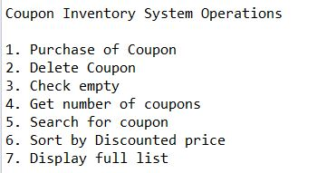
Result Summary/Screenshot
After running the program it will show following options

Slide 16
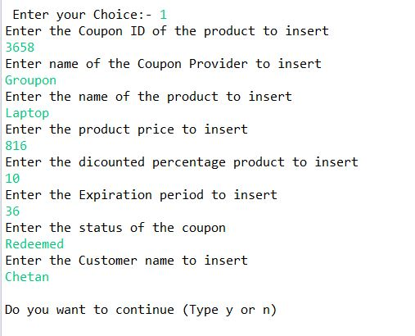
Purchase of Coupon
It will ask from the user to input all the details regarding coupon for adding into the system.

Slide 17
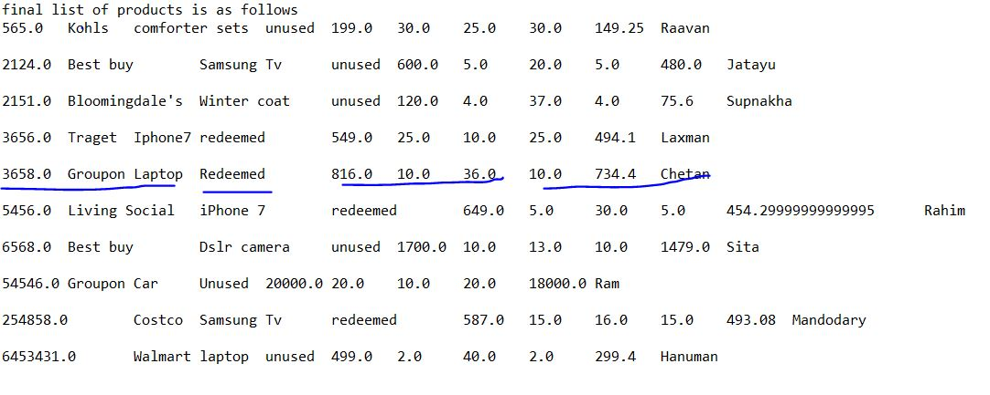
Underlined data was added by user

Slide 18
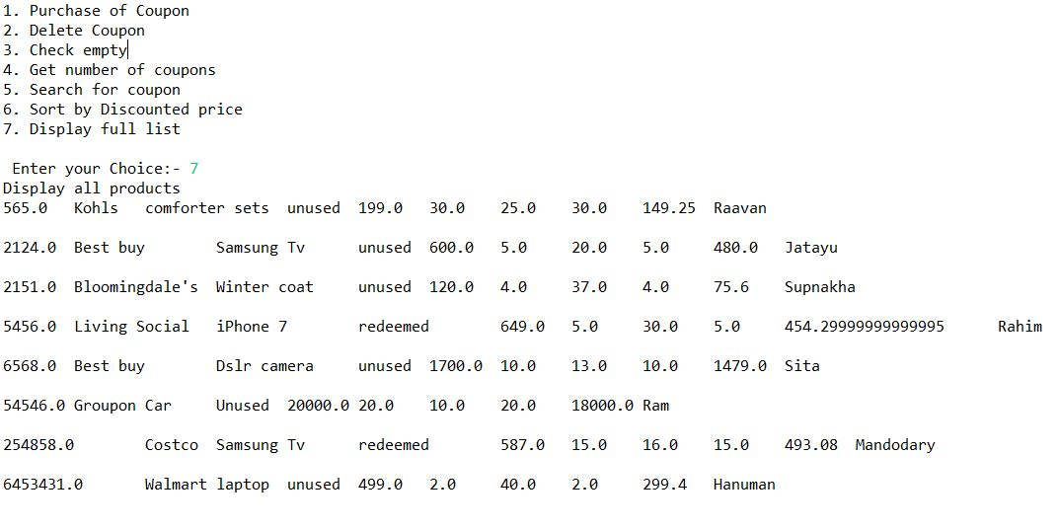

For deleting the coupon:- I have removed the latest added detail of coupon

Slide 19
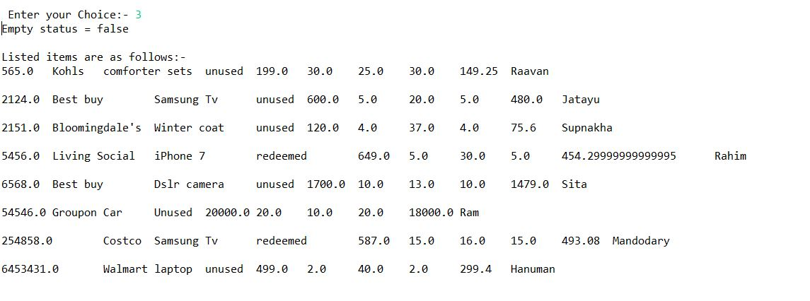
Check empty, if it is empty or having any data

Slide 20
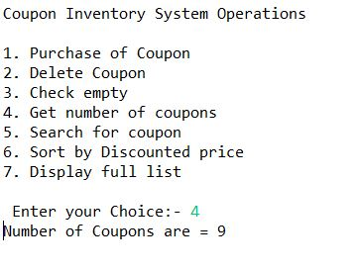
Get number of Coupon

Slide 21
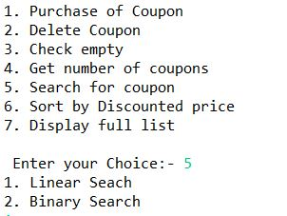
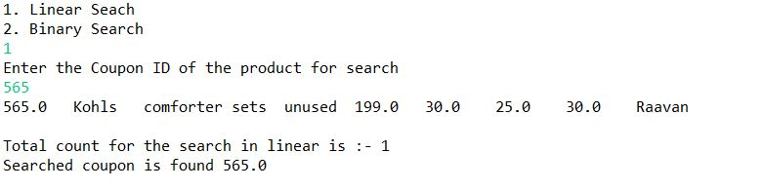
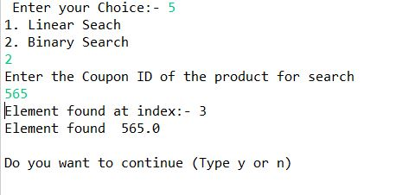
Search option
Linear Search
Binary Search

Slide 22
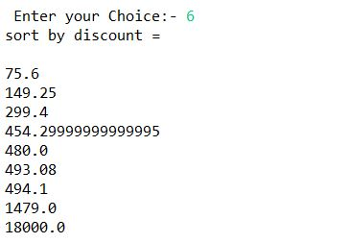
Sorting by Discount Price

Slide 23
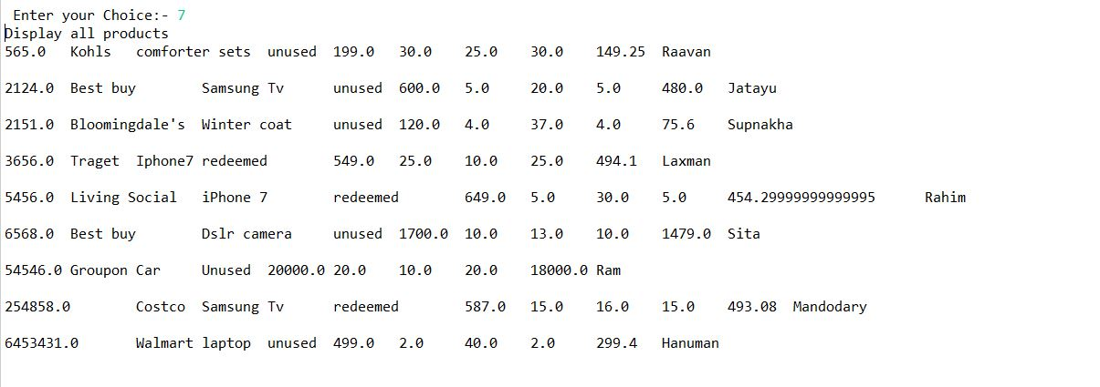
Display all details in the system

